Slide 1
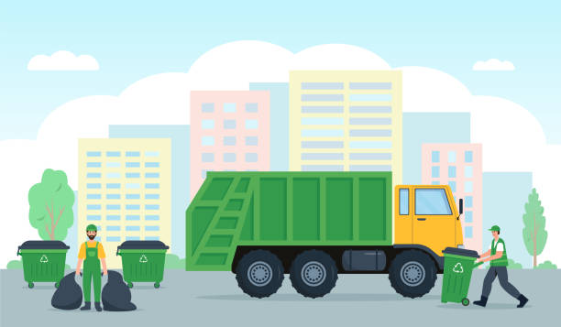
Smart-Efficient Garbage Collection System Using QR Code Technology
Group No. 17- The JimJams
Lakshay Wadhwa, Raj Kumar Aggarwal,
Arha Samanta, Soumyajyoti Das, Abhishek Acharya

Slide 2

Project Idea
Our project intends to use technology to improve the efficiency of waste collection and address problems encountered by both users and garbage collectors. The major goals of this software are to lessen the pollution and health risks posed by garbage, as well as to make life easier for both users and garbage collectors.

Slide 3

Approach
Each home in this waste management system has a fixed Bin with a unique QR Code.
The colour of the bin changes from green to red when a user throws garbage in it and scans its QR code.
Garbage collectors can plan their route by looking at the map and identifying all of the bins that have been marked in red.
After the bin has been emptied, the collector scans the corresponding QR code to return the bin's colour to green.
Homeowners may view the garbage collector's current position, and the municipal office can monitor statistics such as the number of emptied bins, bin colours, and other information, that too in real time.

Slide 4
Database Structure
Collector
Collector Id
Location (Permanent & Live)
Rating
List of Users Allocated
User
User Id
Collector Allocated
Bin Status
Location
Address etc.
Complaint
From User
About Collector
To Admin
Contains Complaint Date/Time, Complaint Message,
Admin
Can see details about all the collectors
Can See all the complaints by users, and after resolving can send them a resolving message

Slide 5
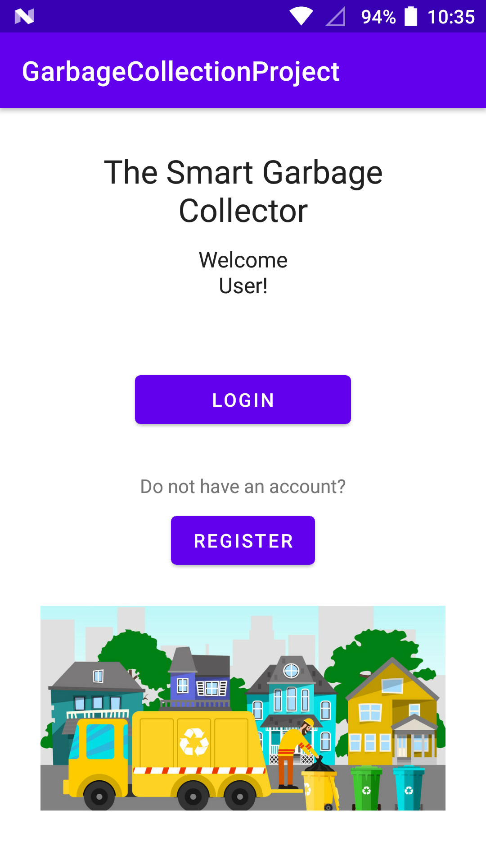
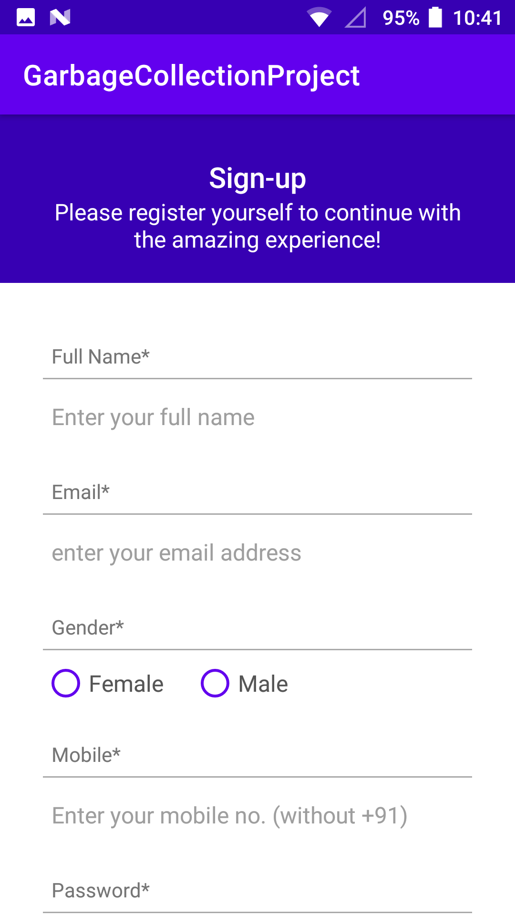
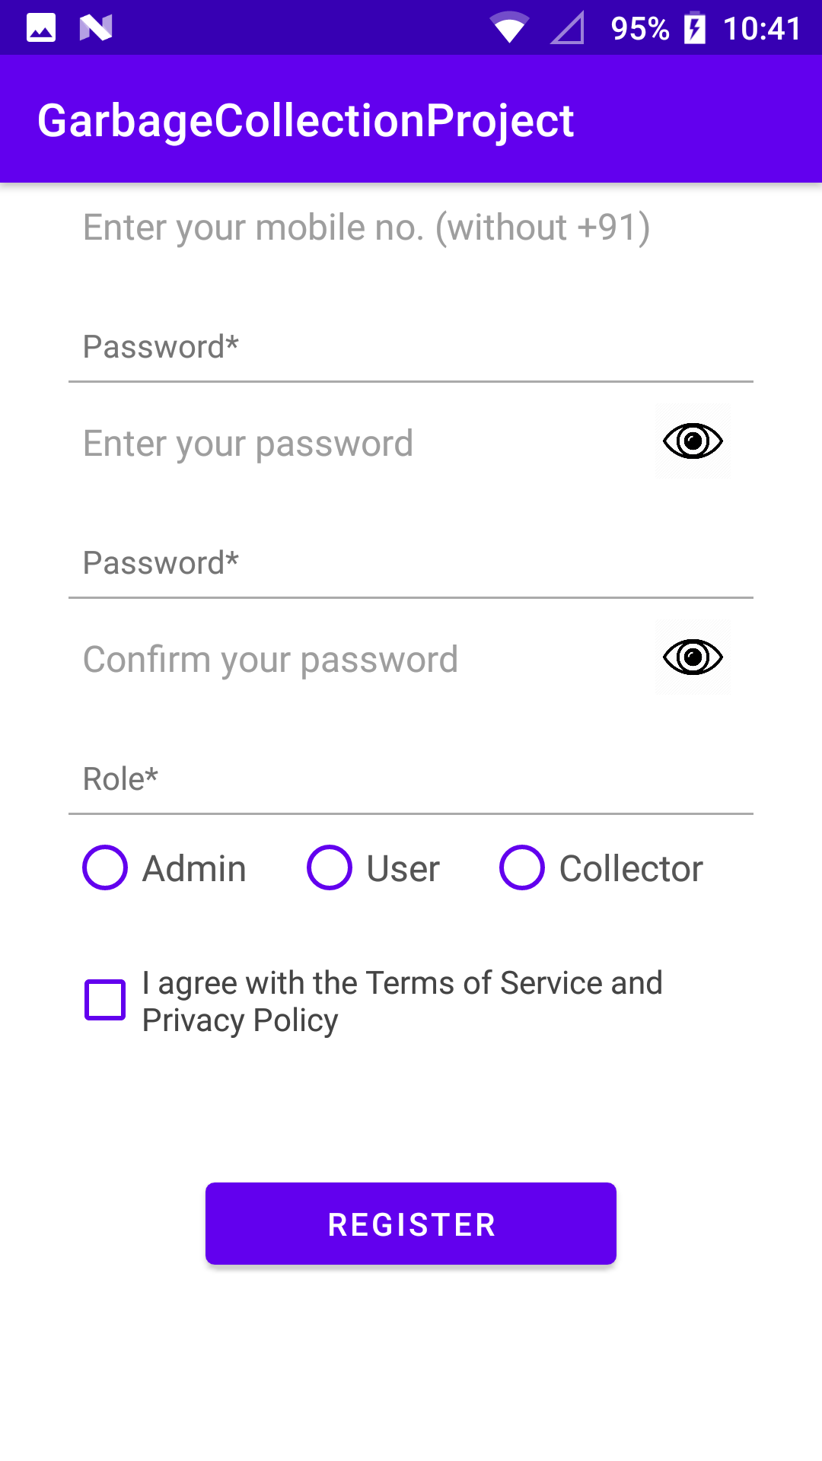
Home Page and Sign Up

Slide 6
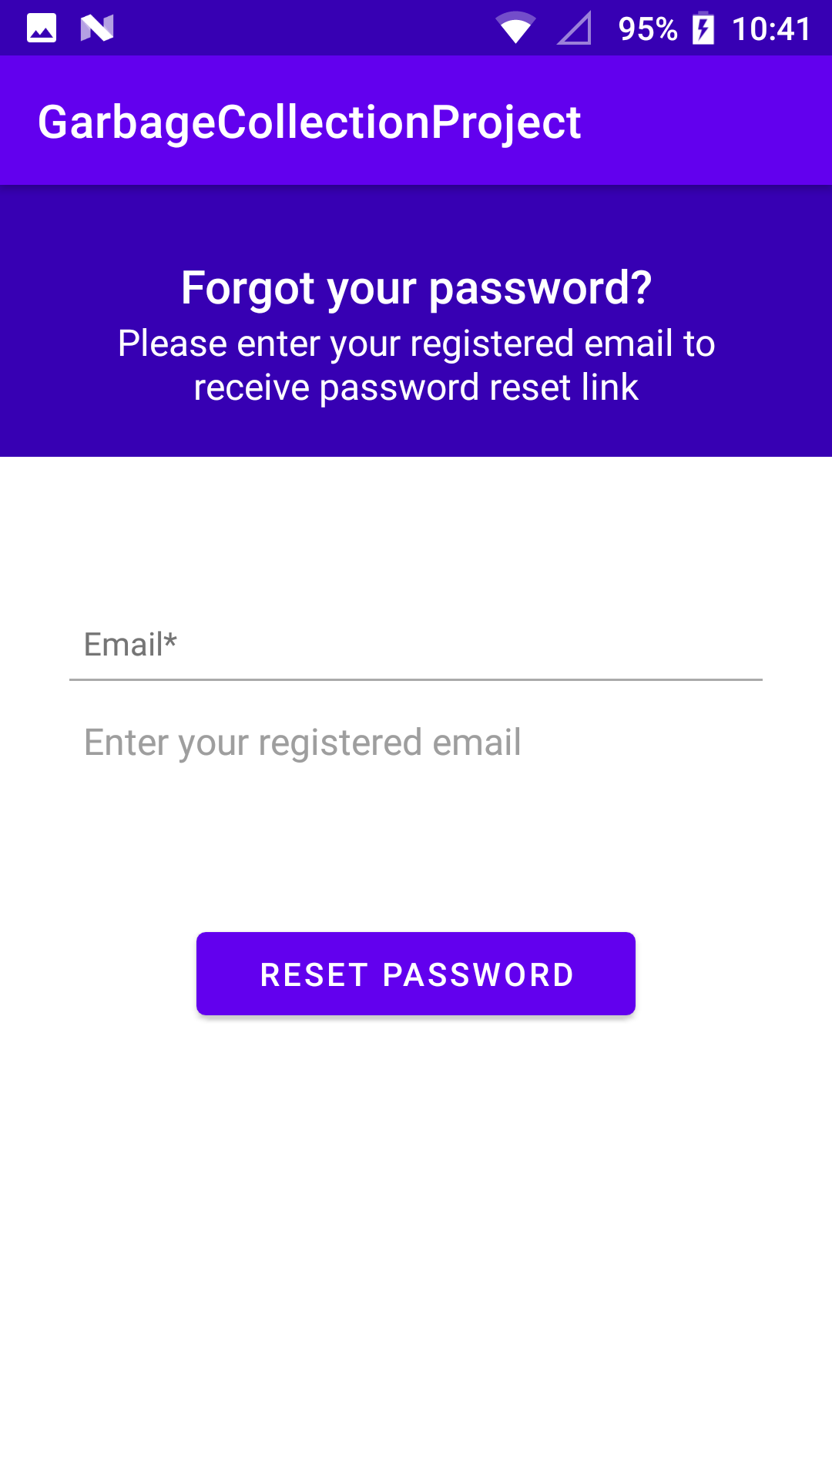
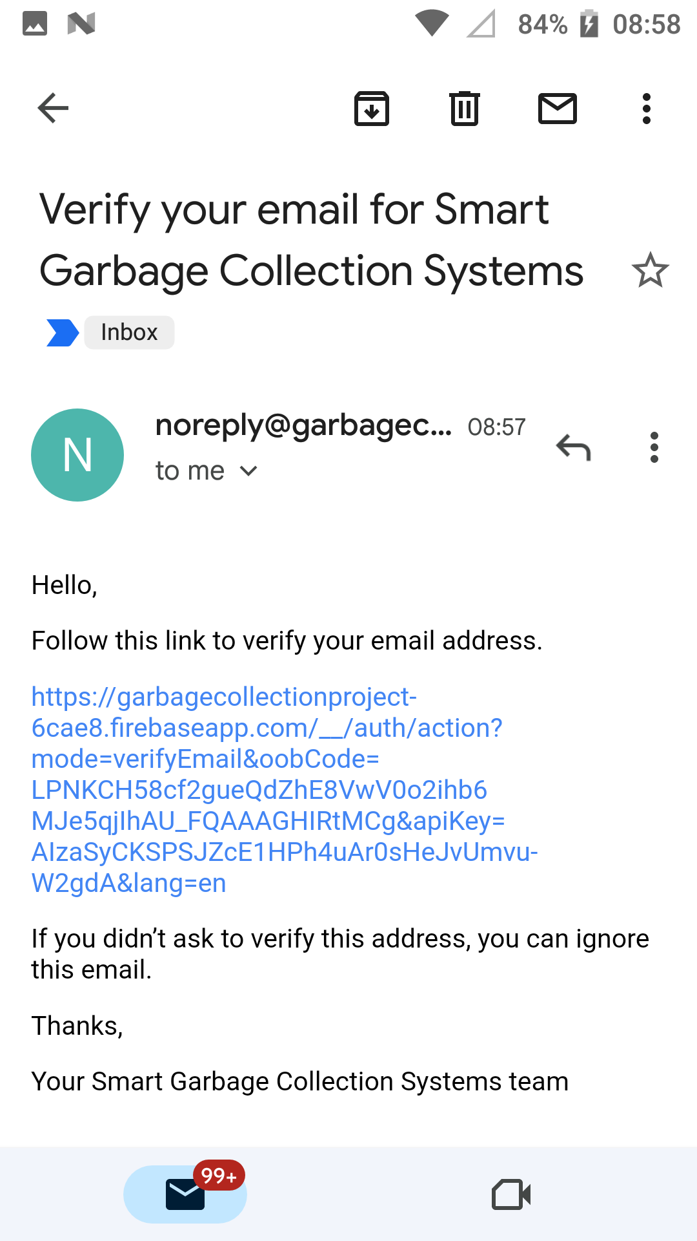

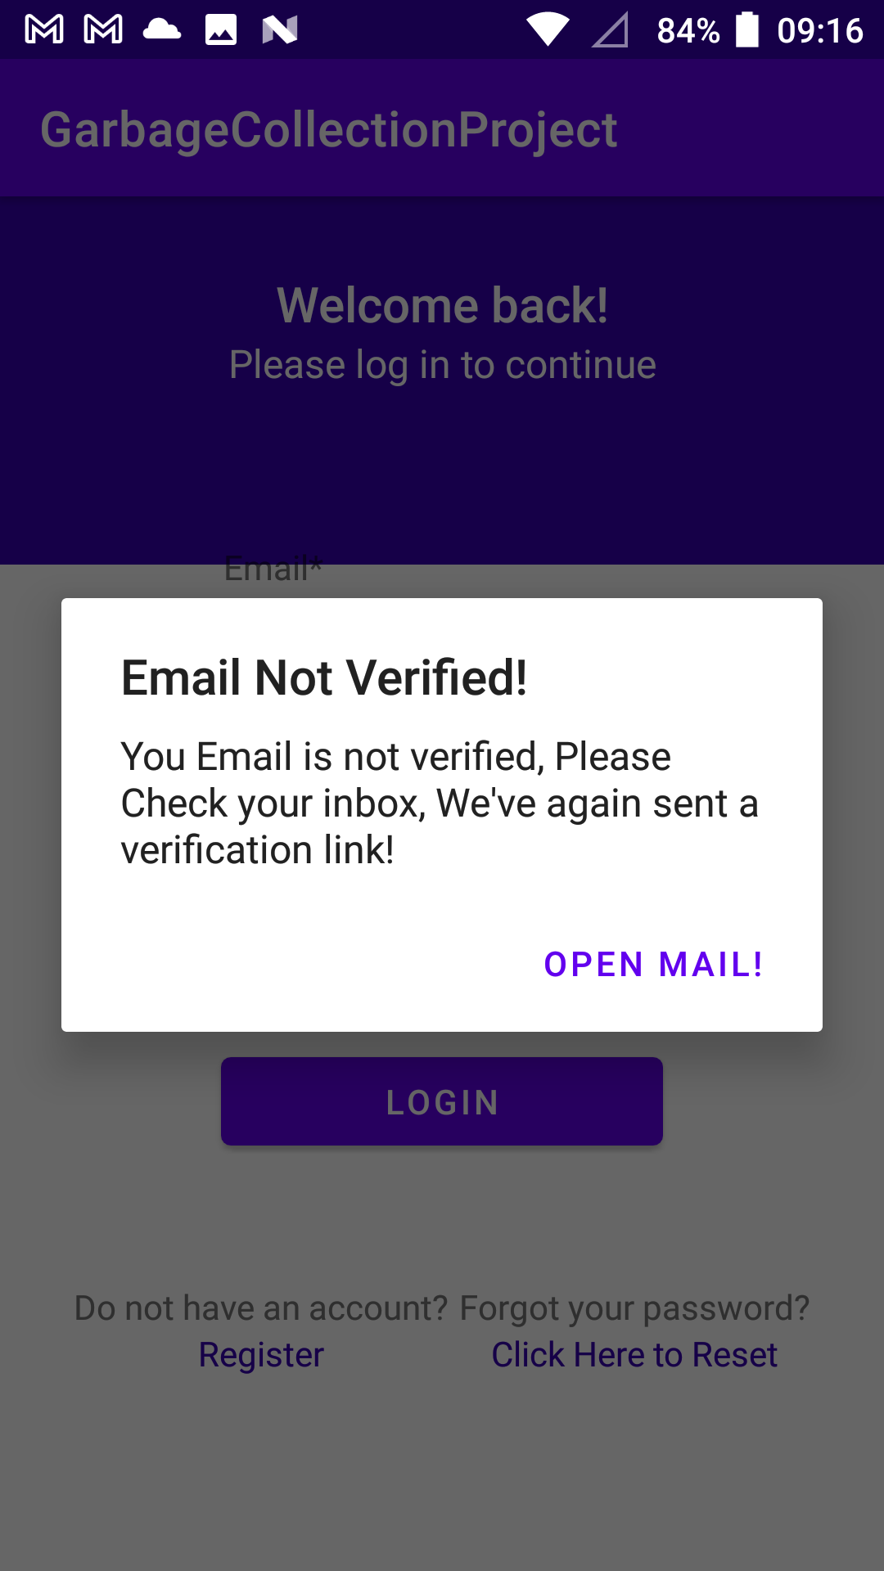
Sign Up (Contd.)

Slide 7
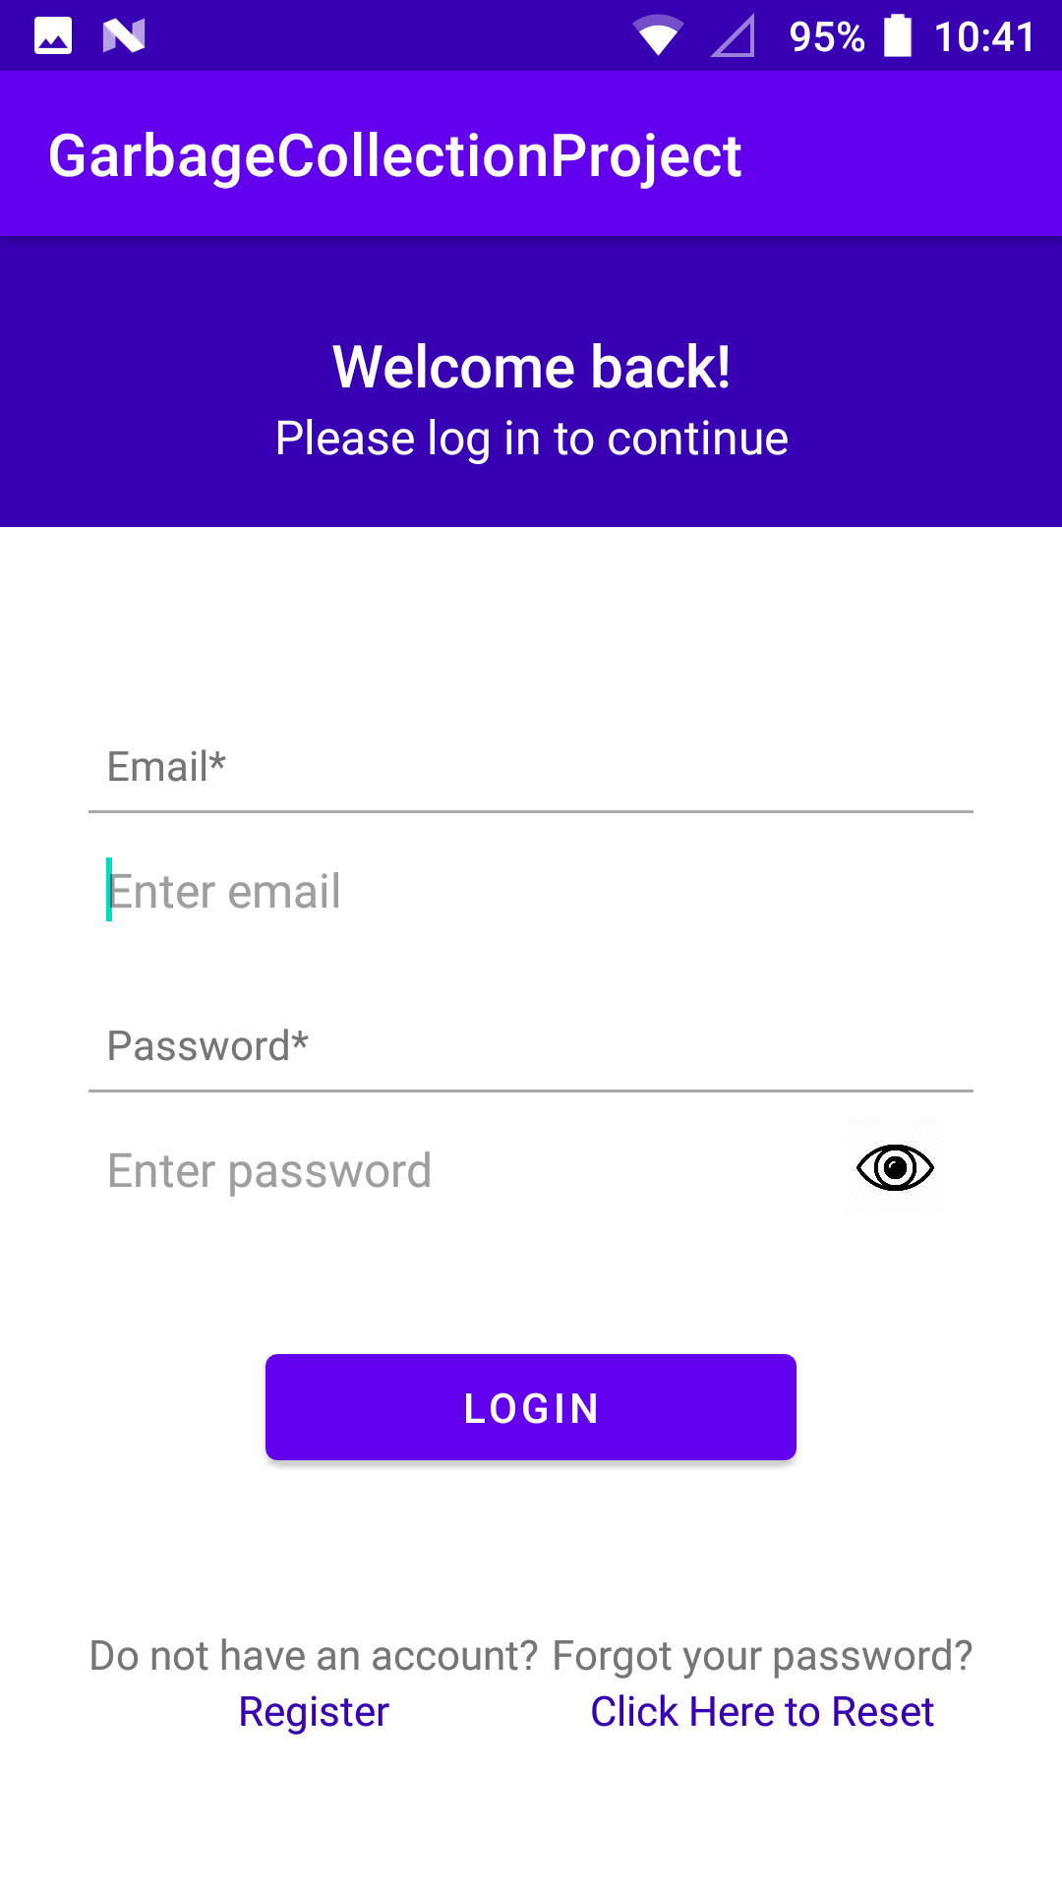
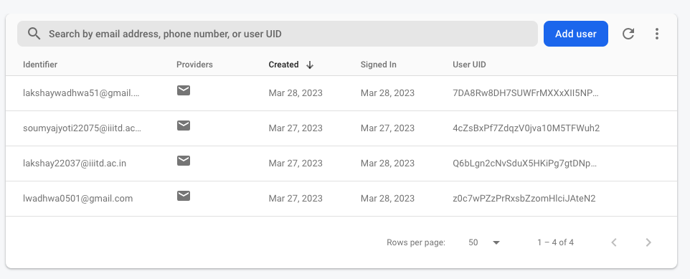
Login Page and Firebase

Slide 8
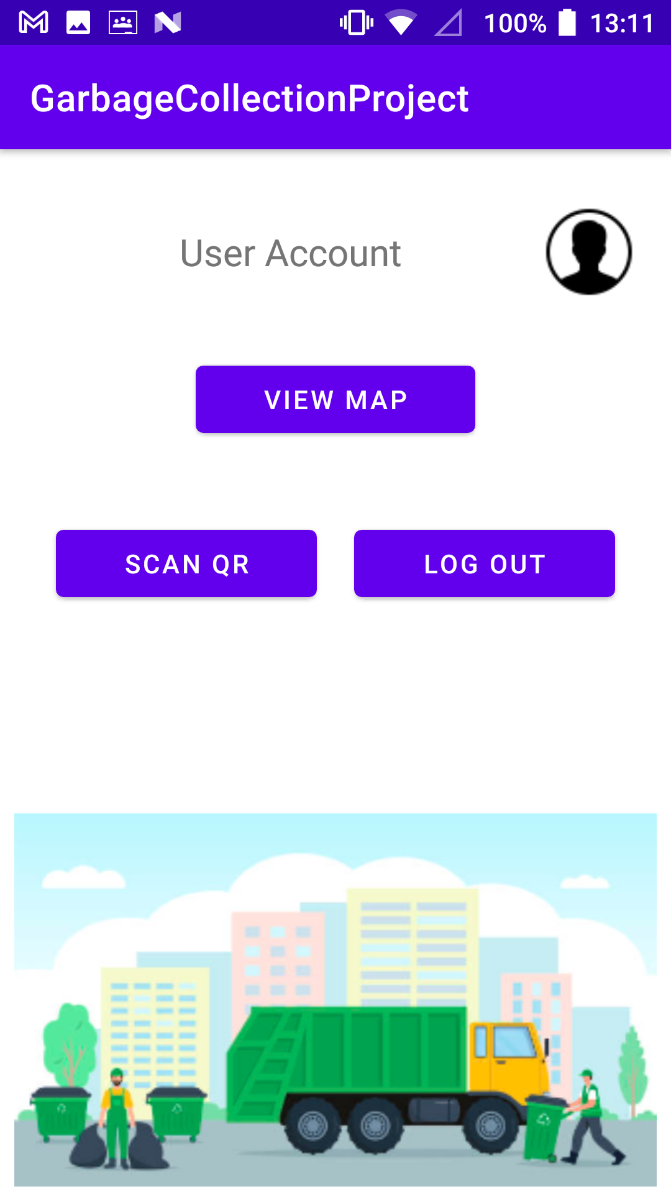
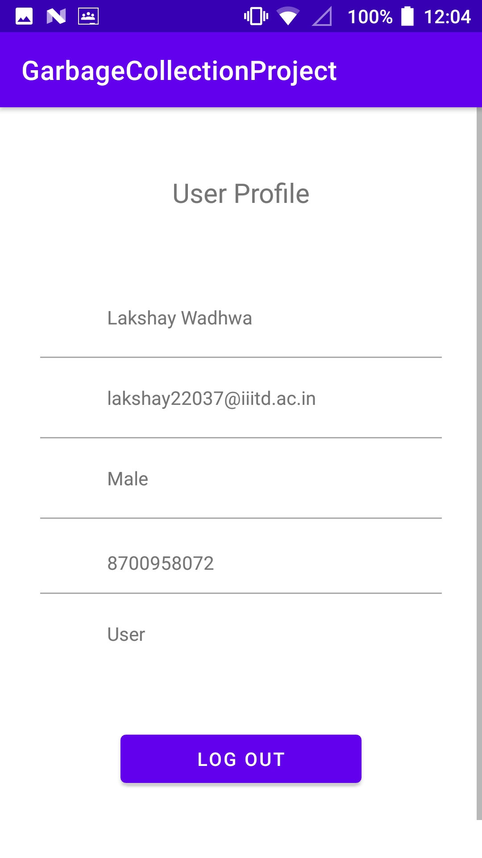
User Login

Slide 9
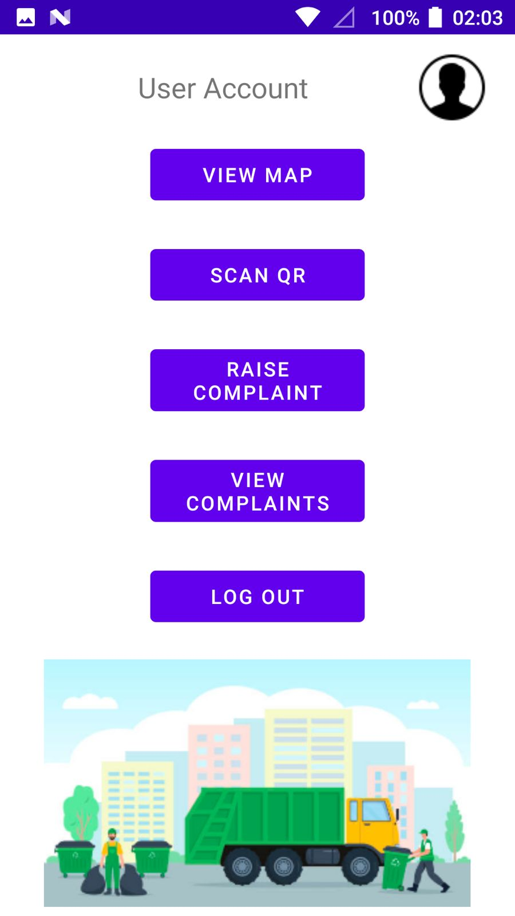
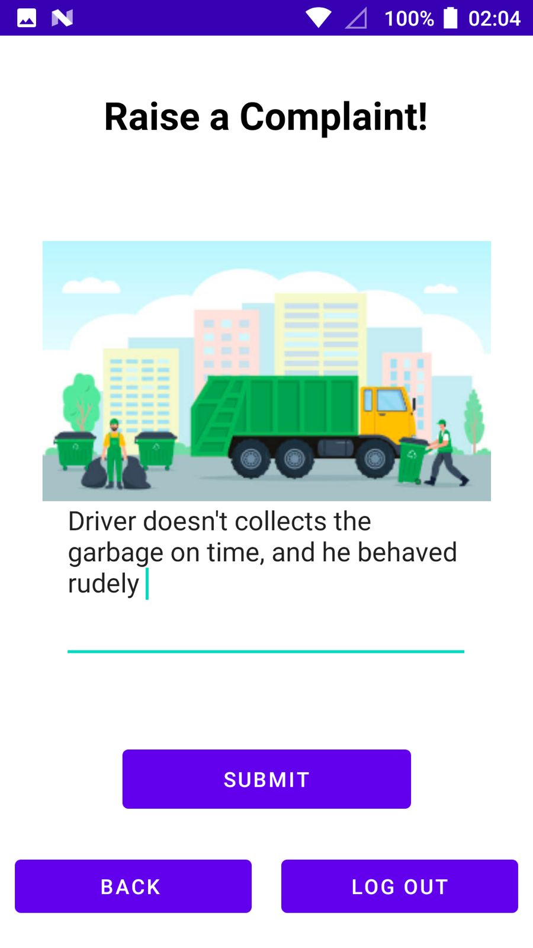
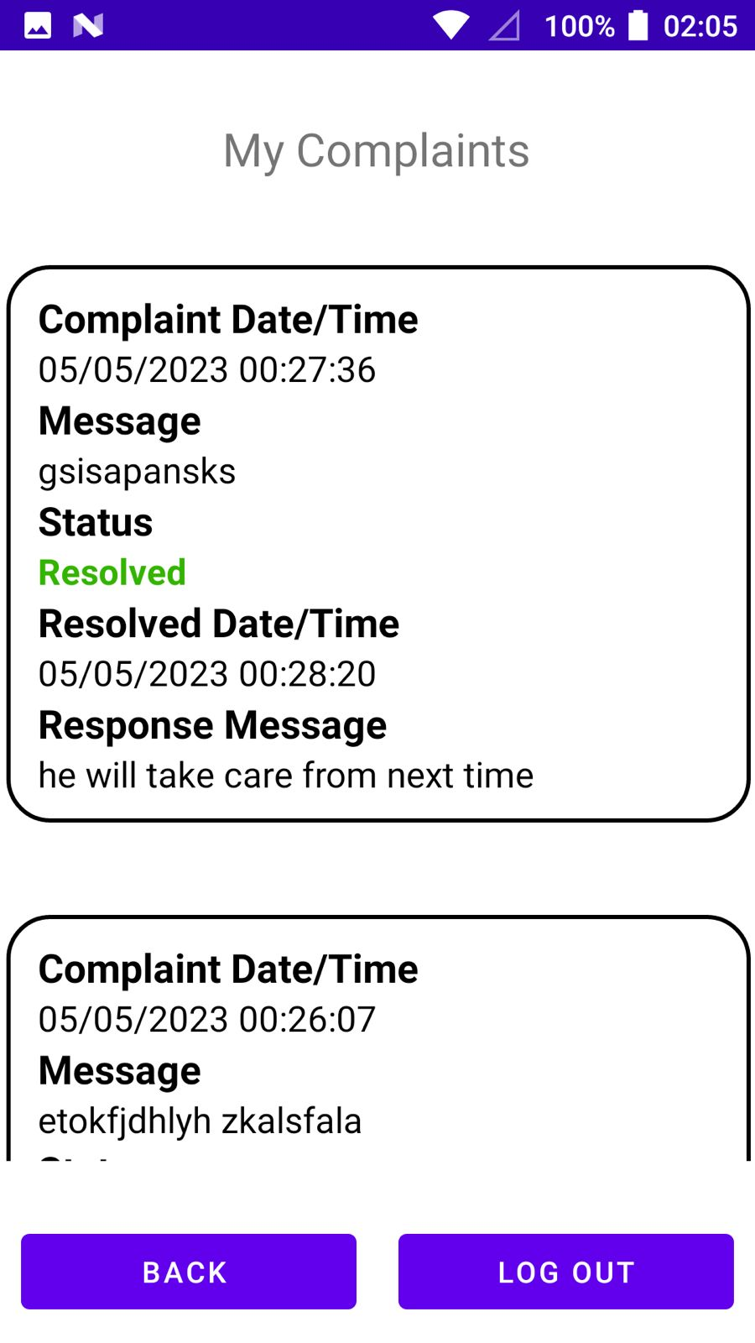
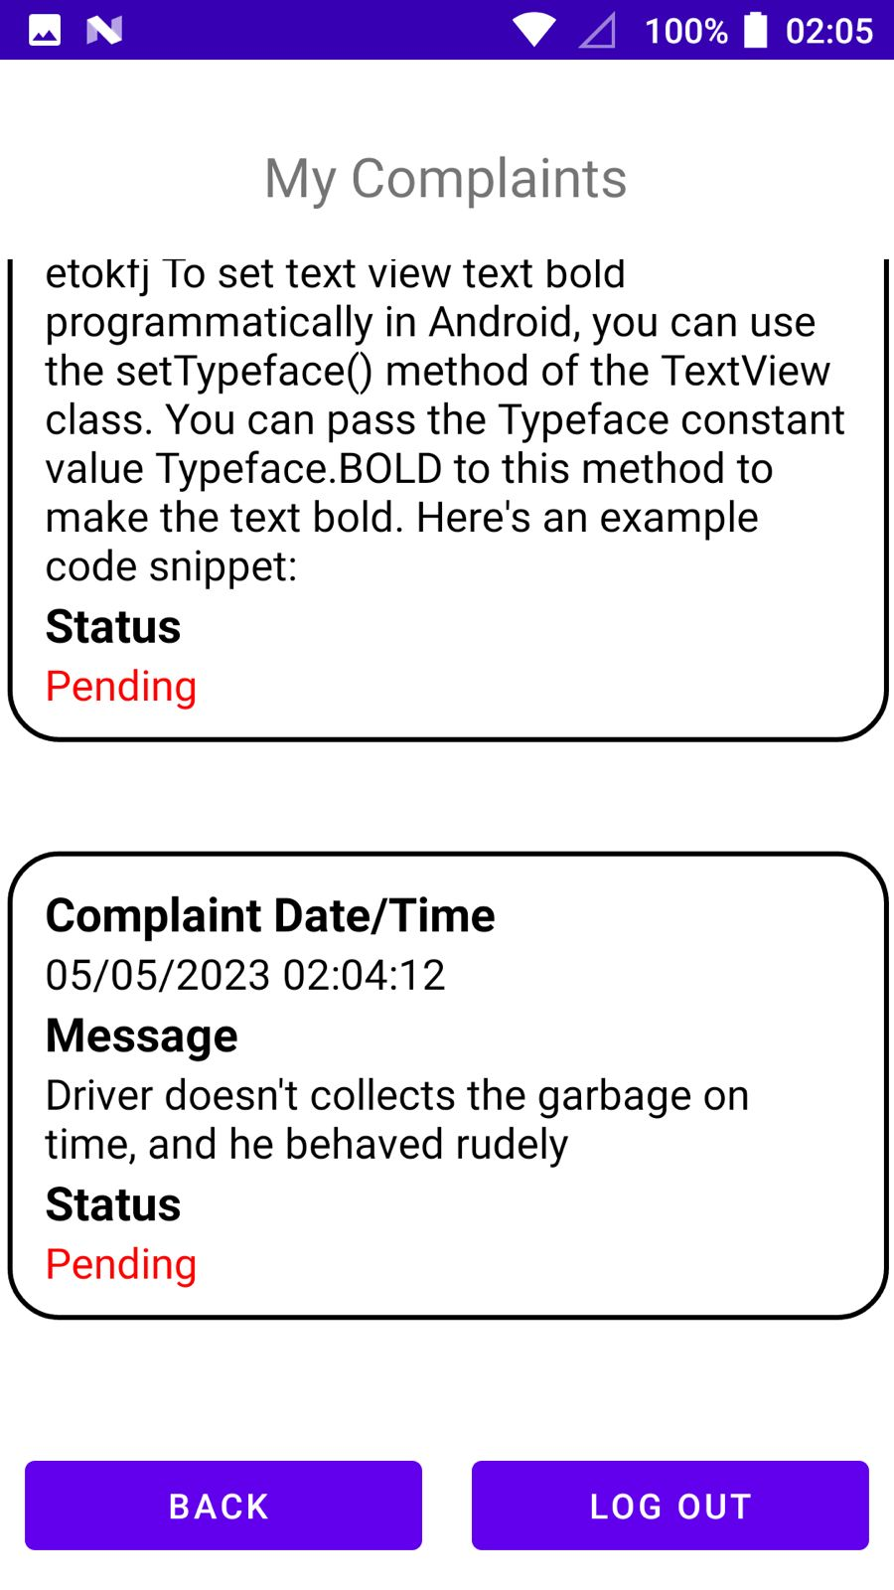
Complaint by Users

Slide 10
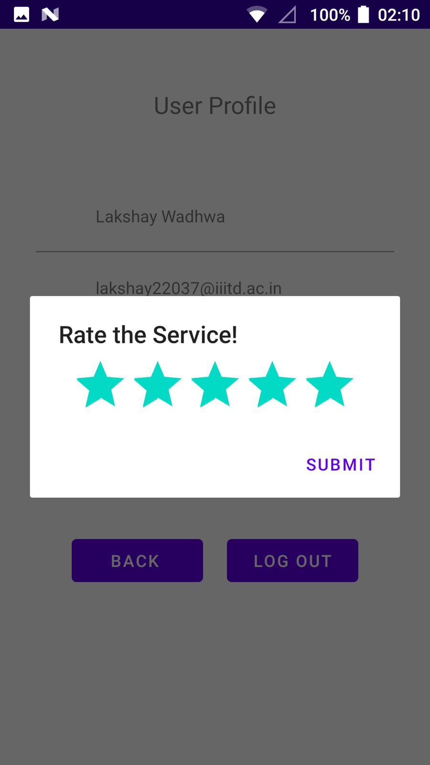
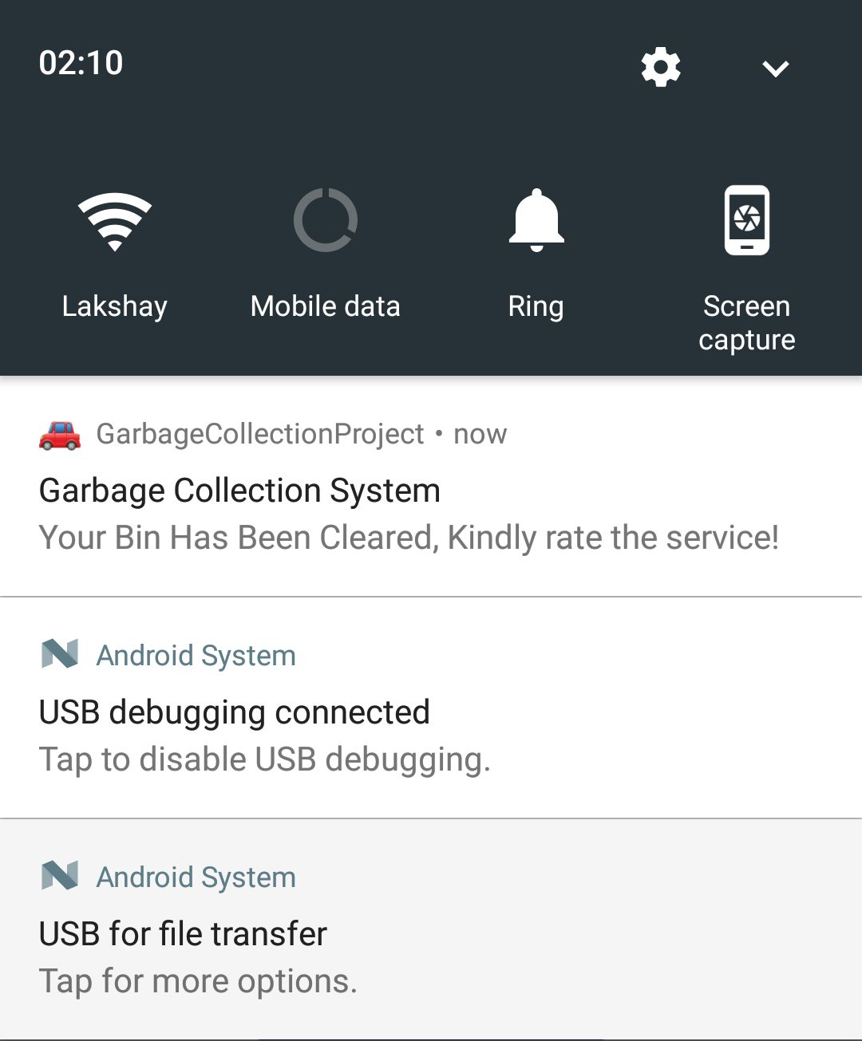
User gives Service Feedback
Upon clicking the Push notification

Slide 11
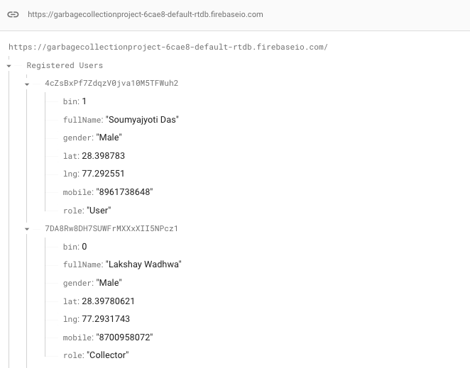
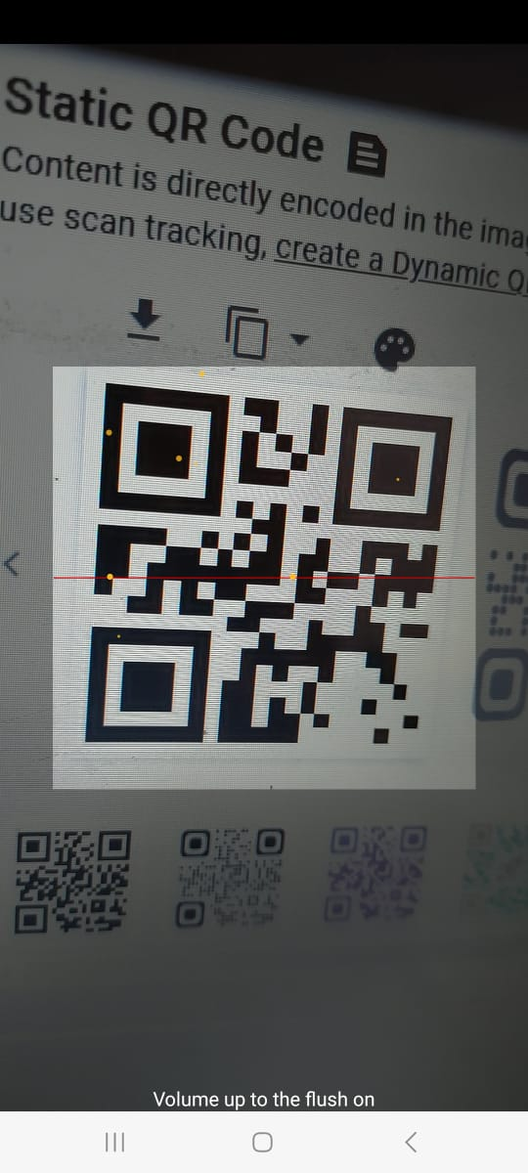
QR Code Scanner and Database Integration

Slide 12
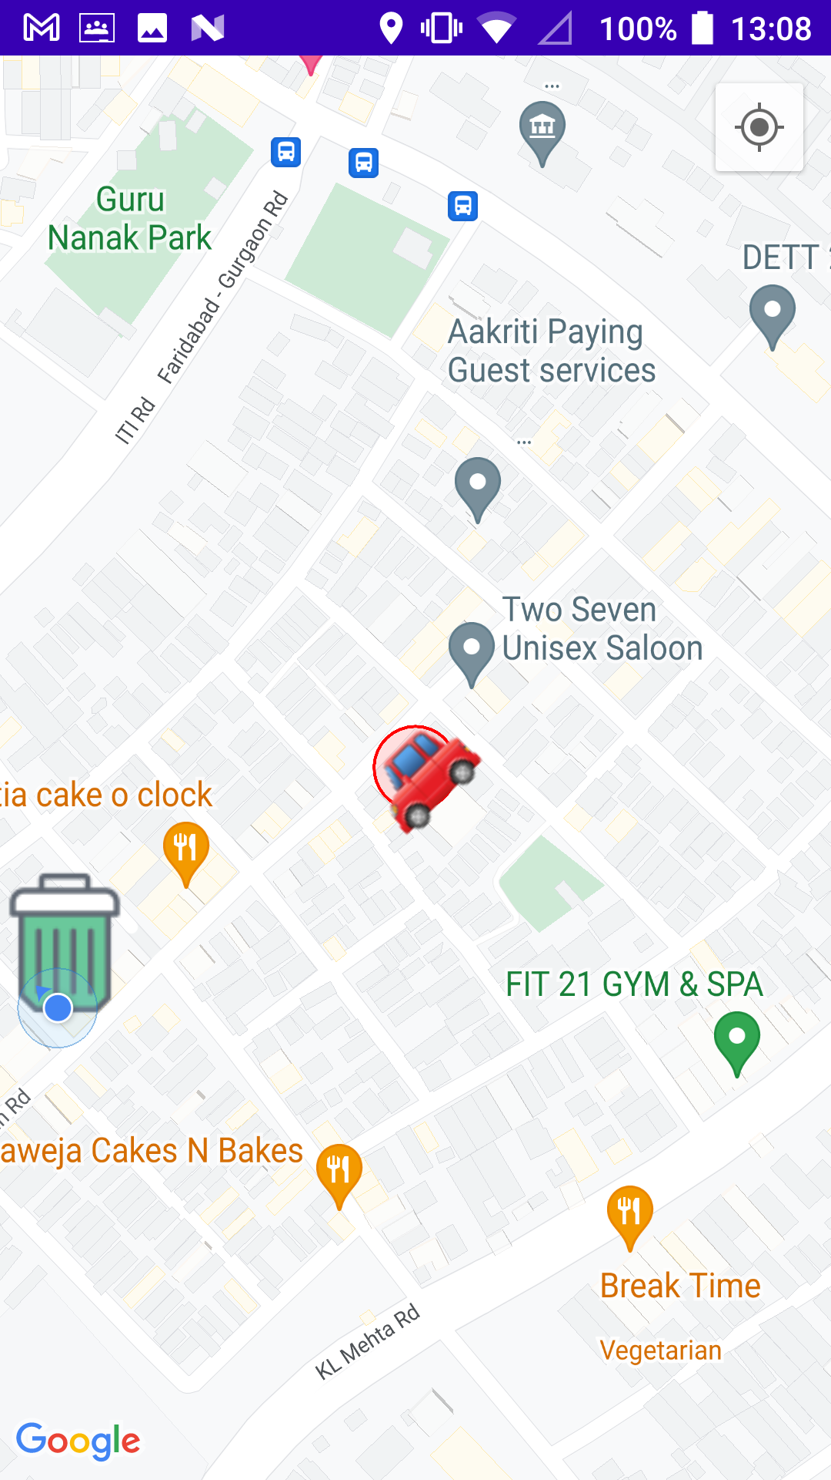
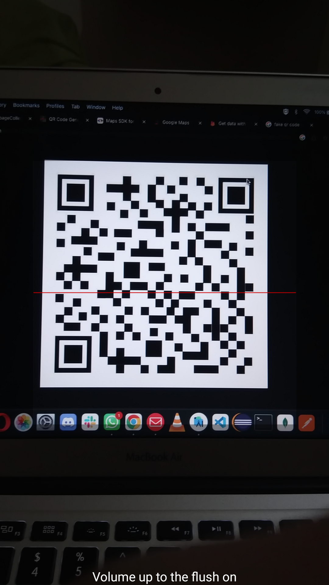
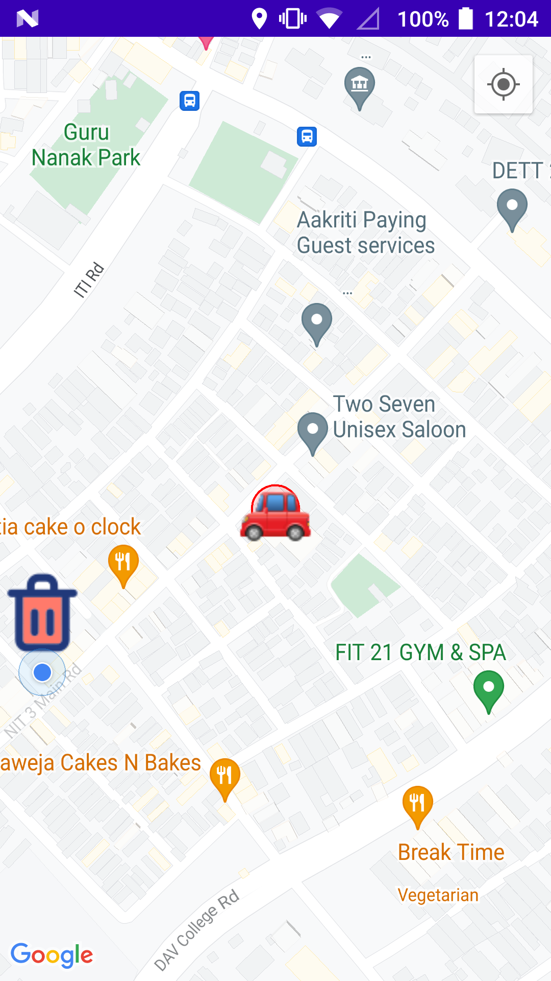
Map Implementation

Slide 13
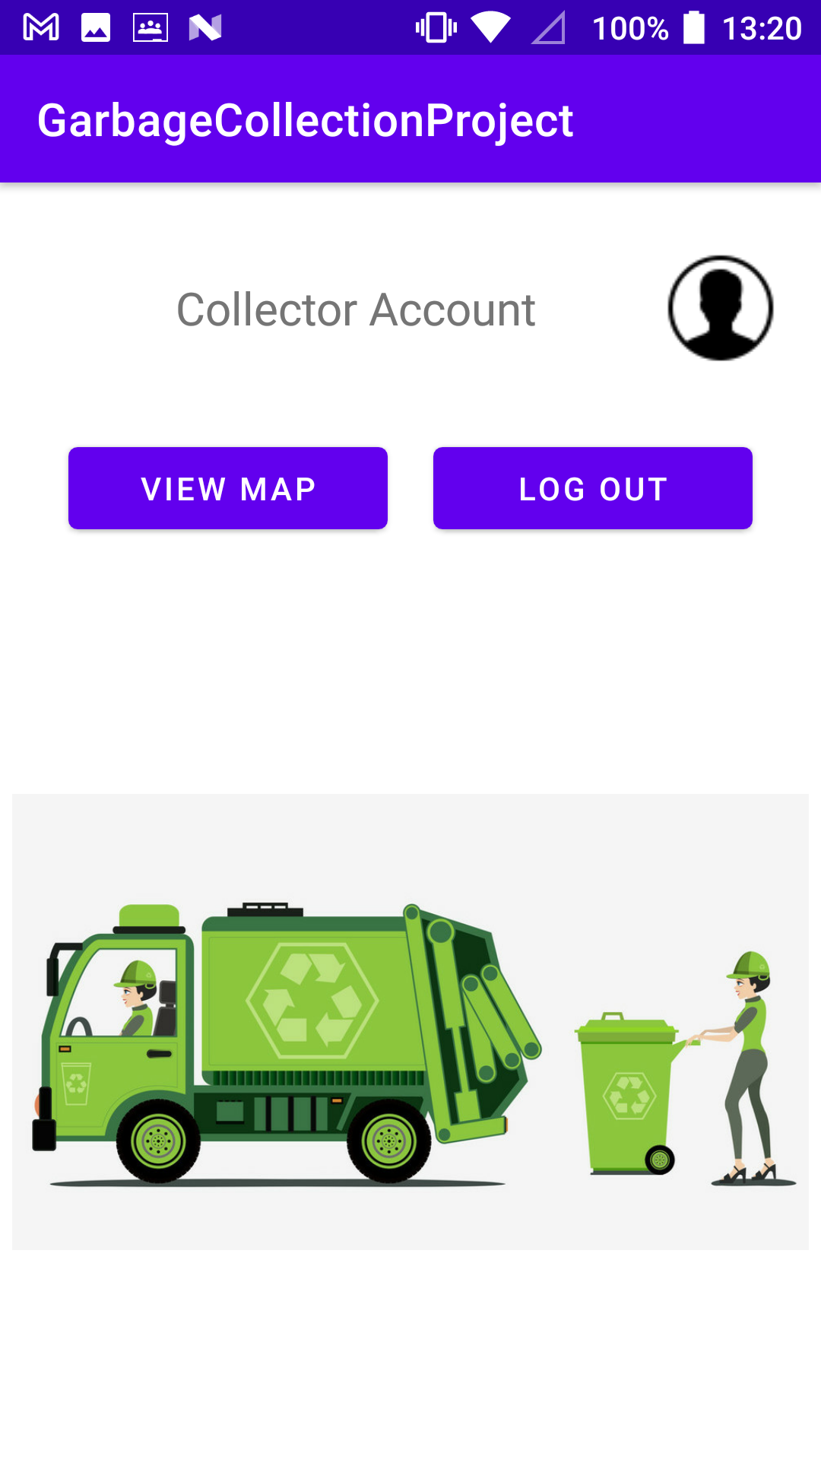
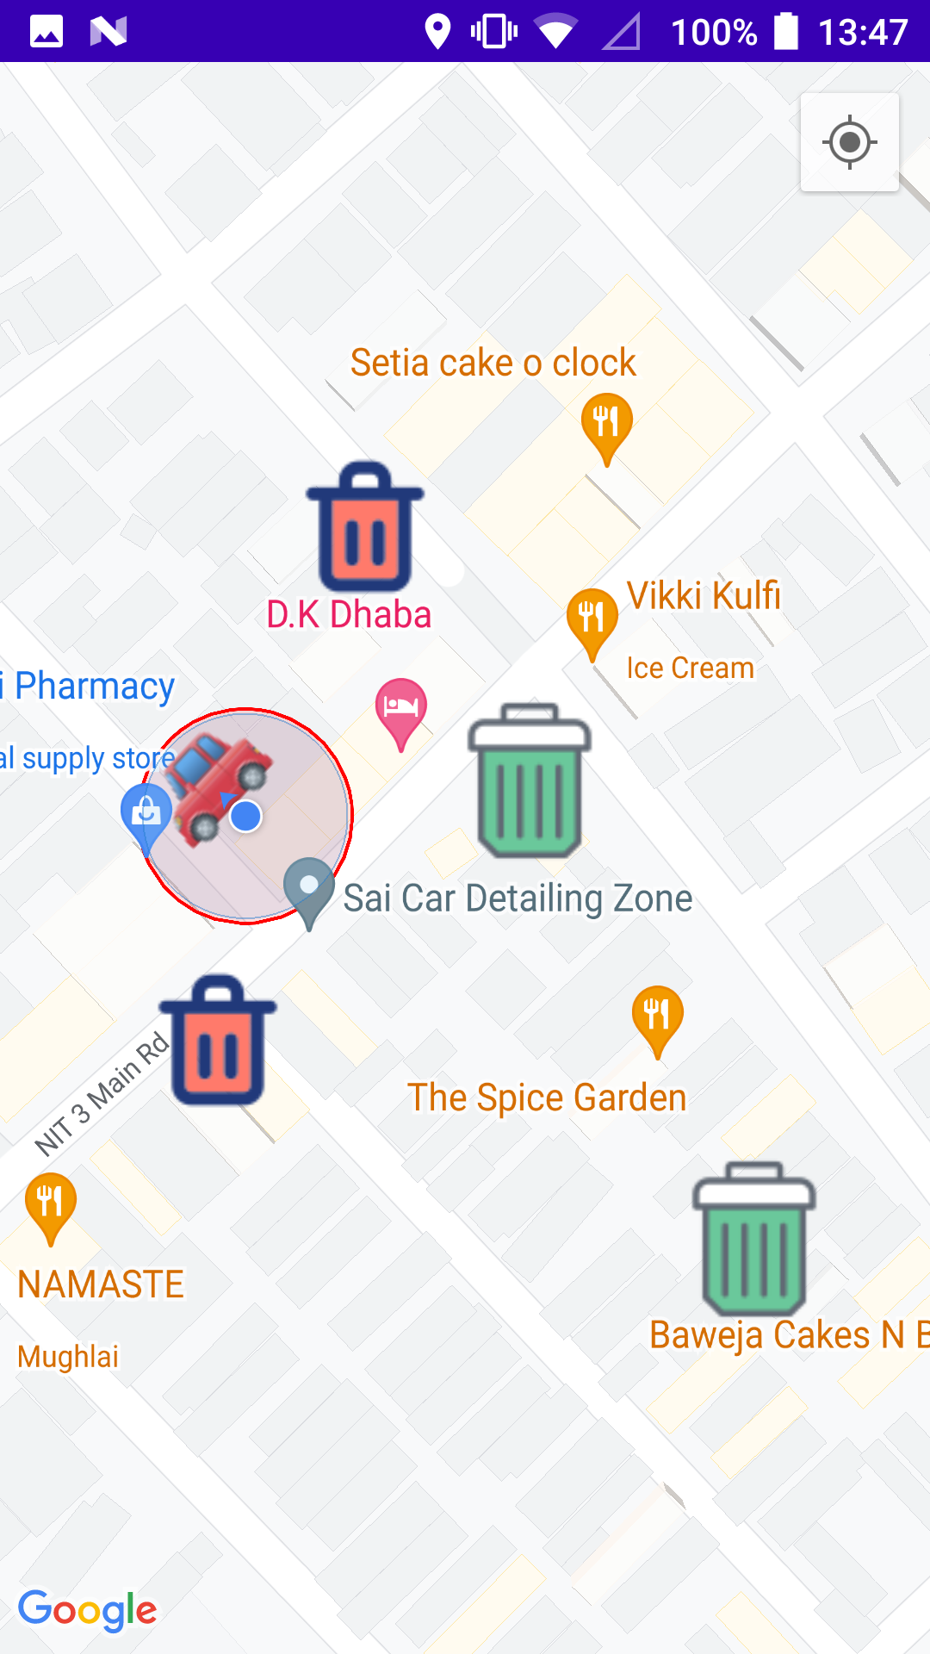
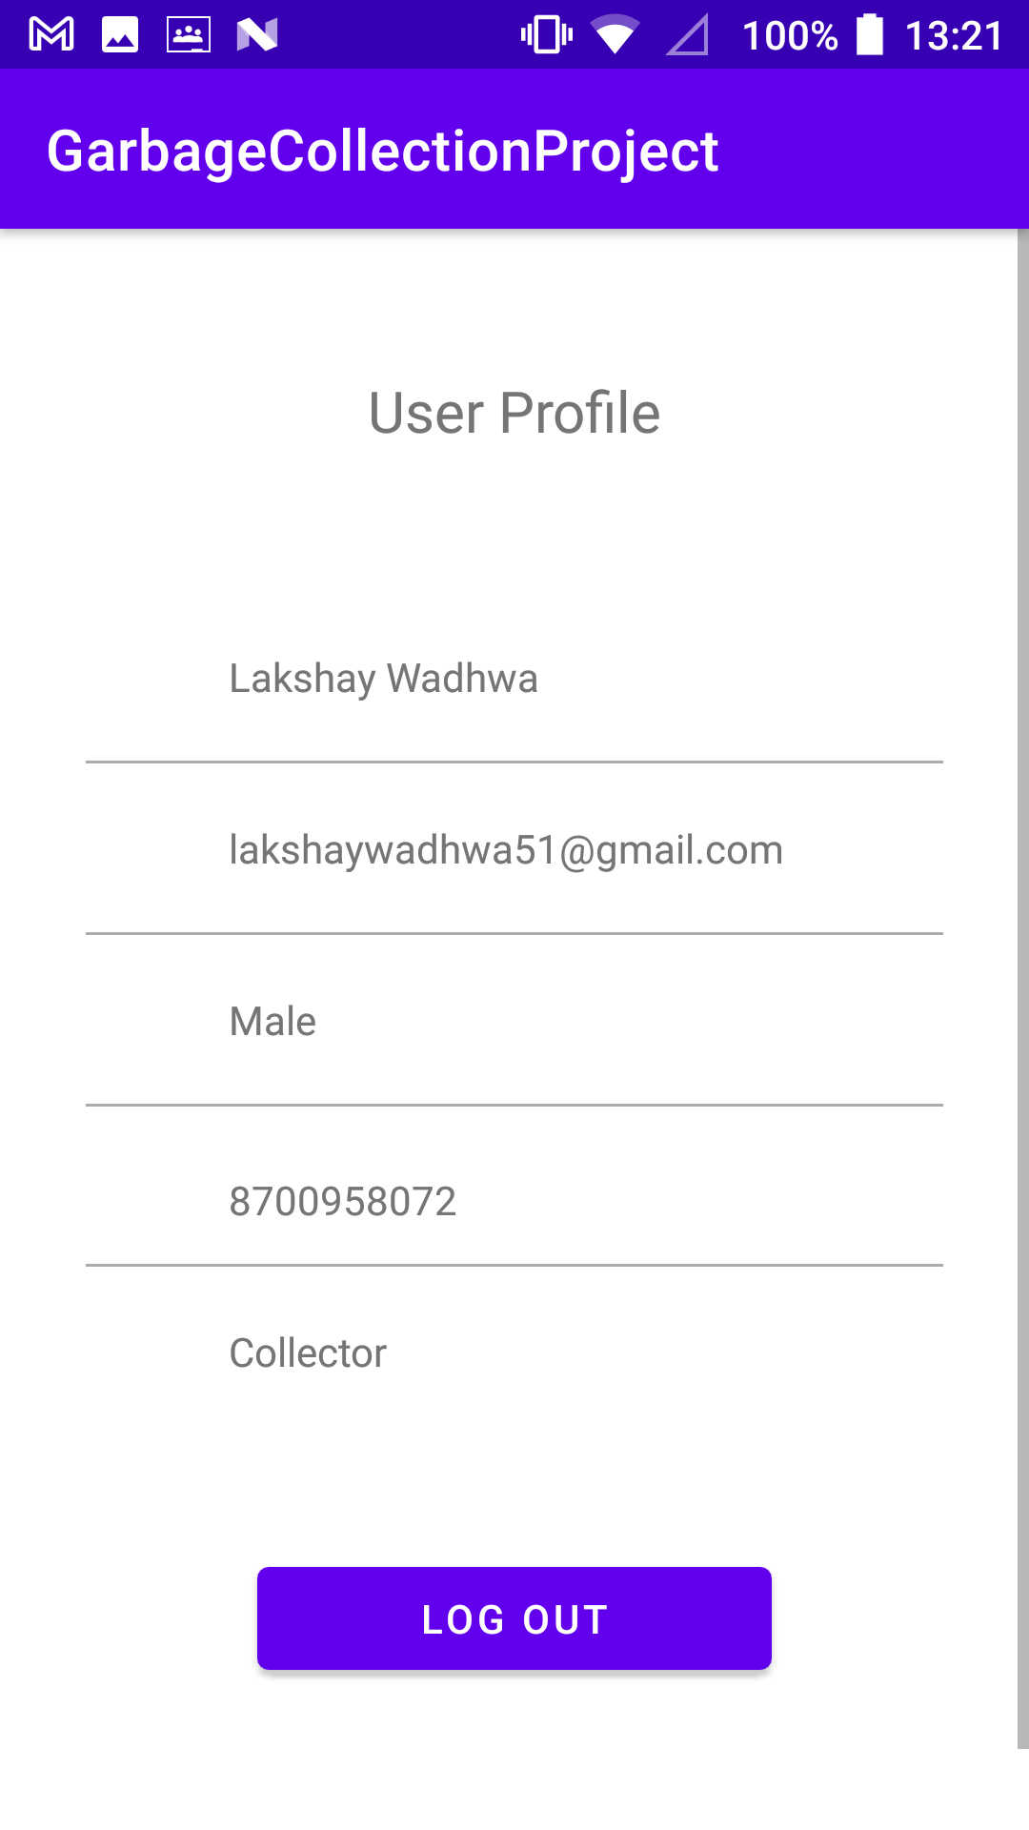
Collector Login

Slide 14
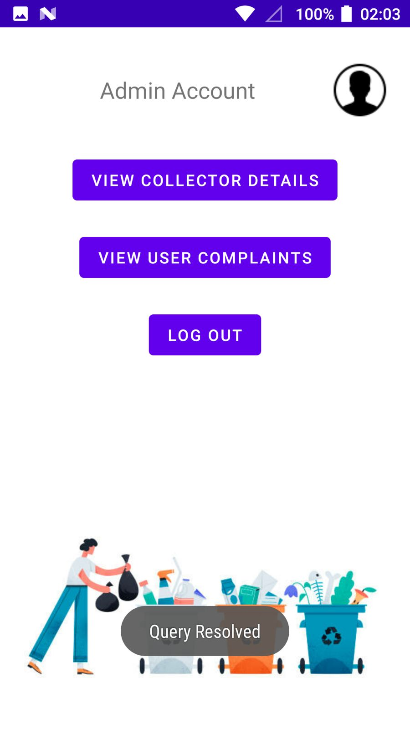
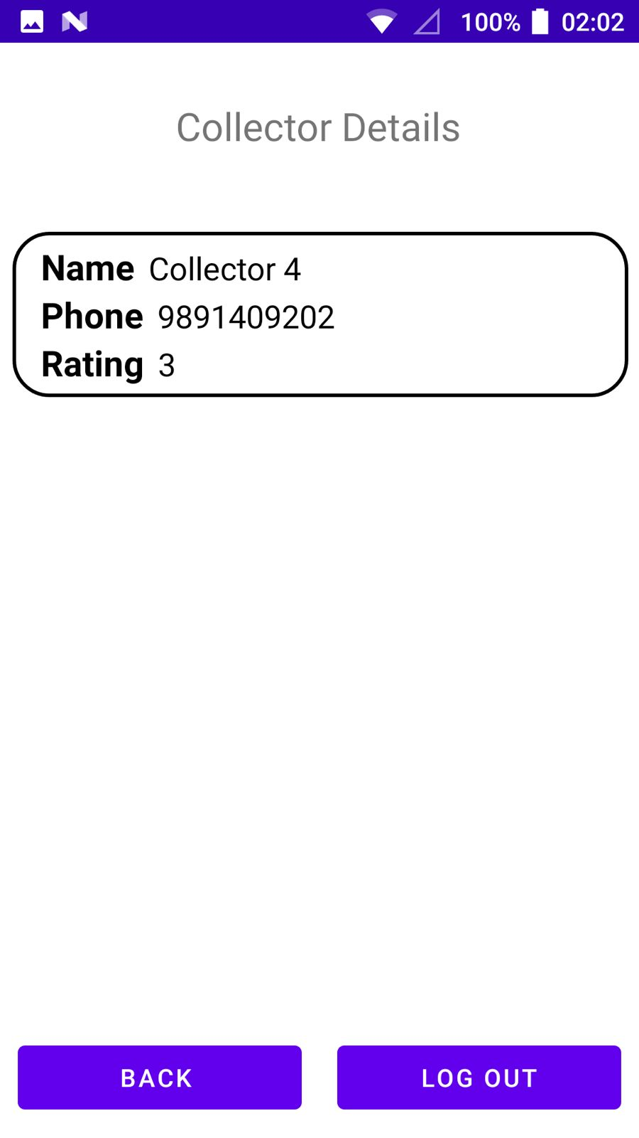
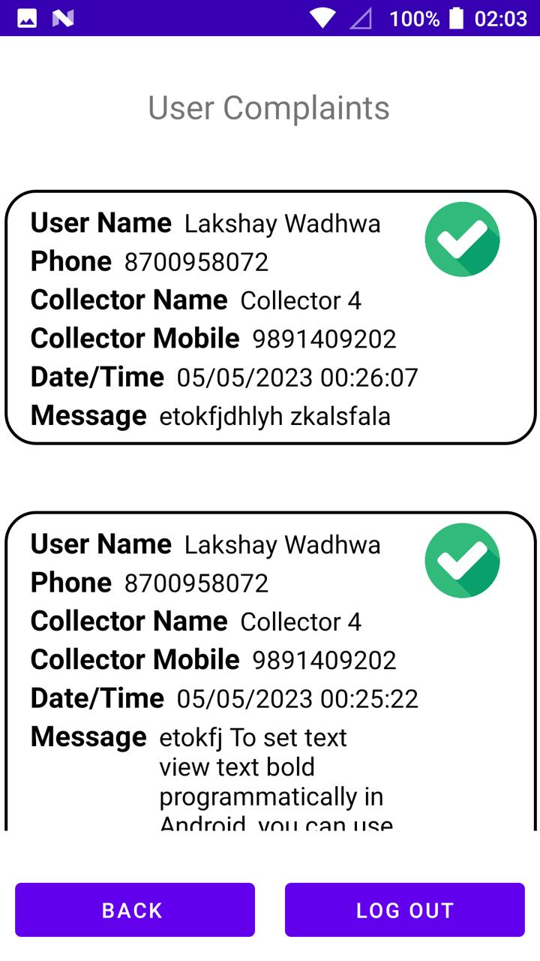
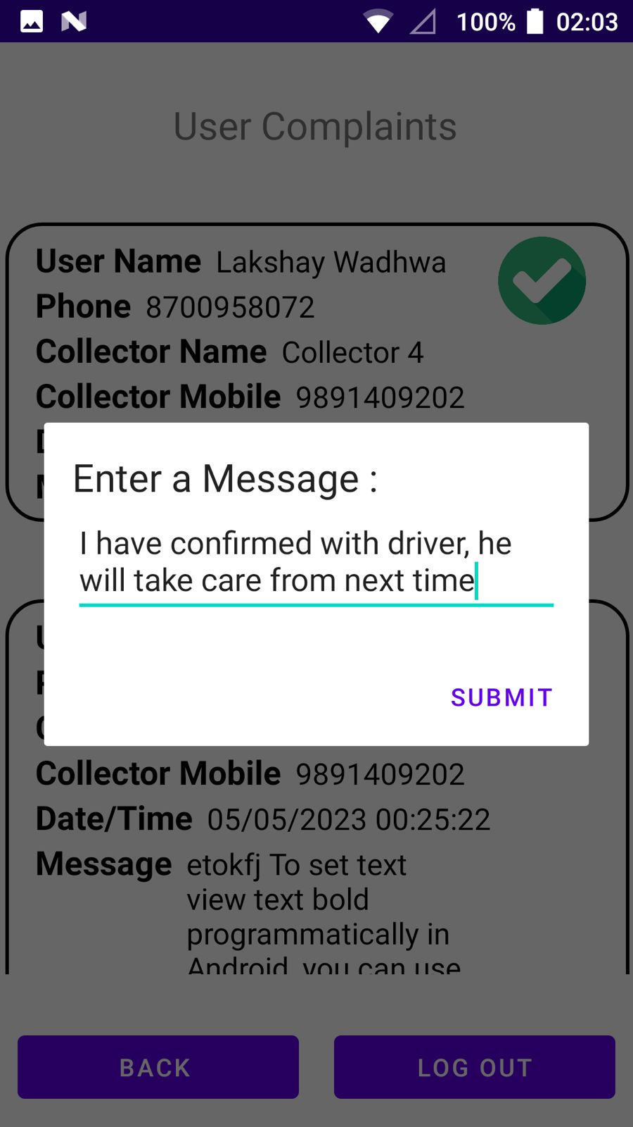
Admin Login

Slide 15

Features Implemented:
Notifying users when their Bin has been cleared.
If the garbage is not collected for a long time, users can complain to the administration.
Citizen can rate the service, and that rating will be stored as incentive points for the collector.
Estimated time for garbage truck to reach the Bin
Functionalities as an Admin.
Allotment of Garbage trucks to specific localities and Bins.

Slide 16
Thank You!
Group No. 17- The JimJams
Lakshay Wadhwa, Raj Kumar Aggarwal,
Arha Samanta, Soumyajyoti Das, Abhishek Acharya

